Slide 1
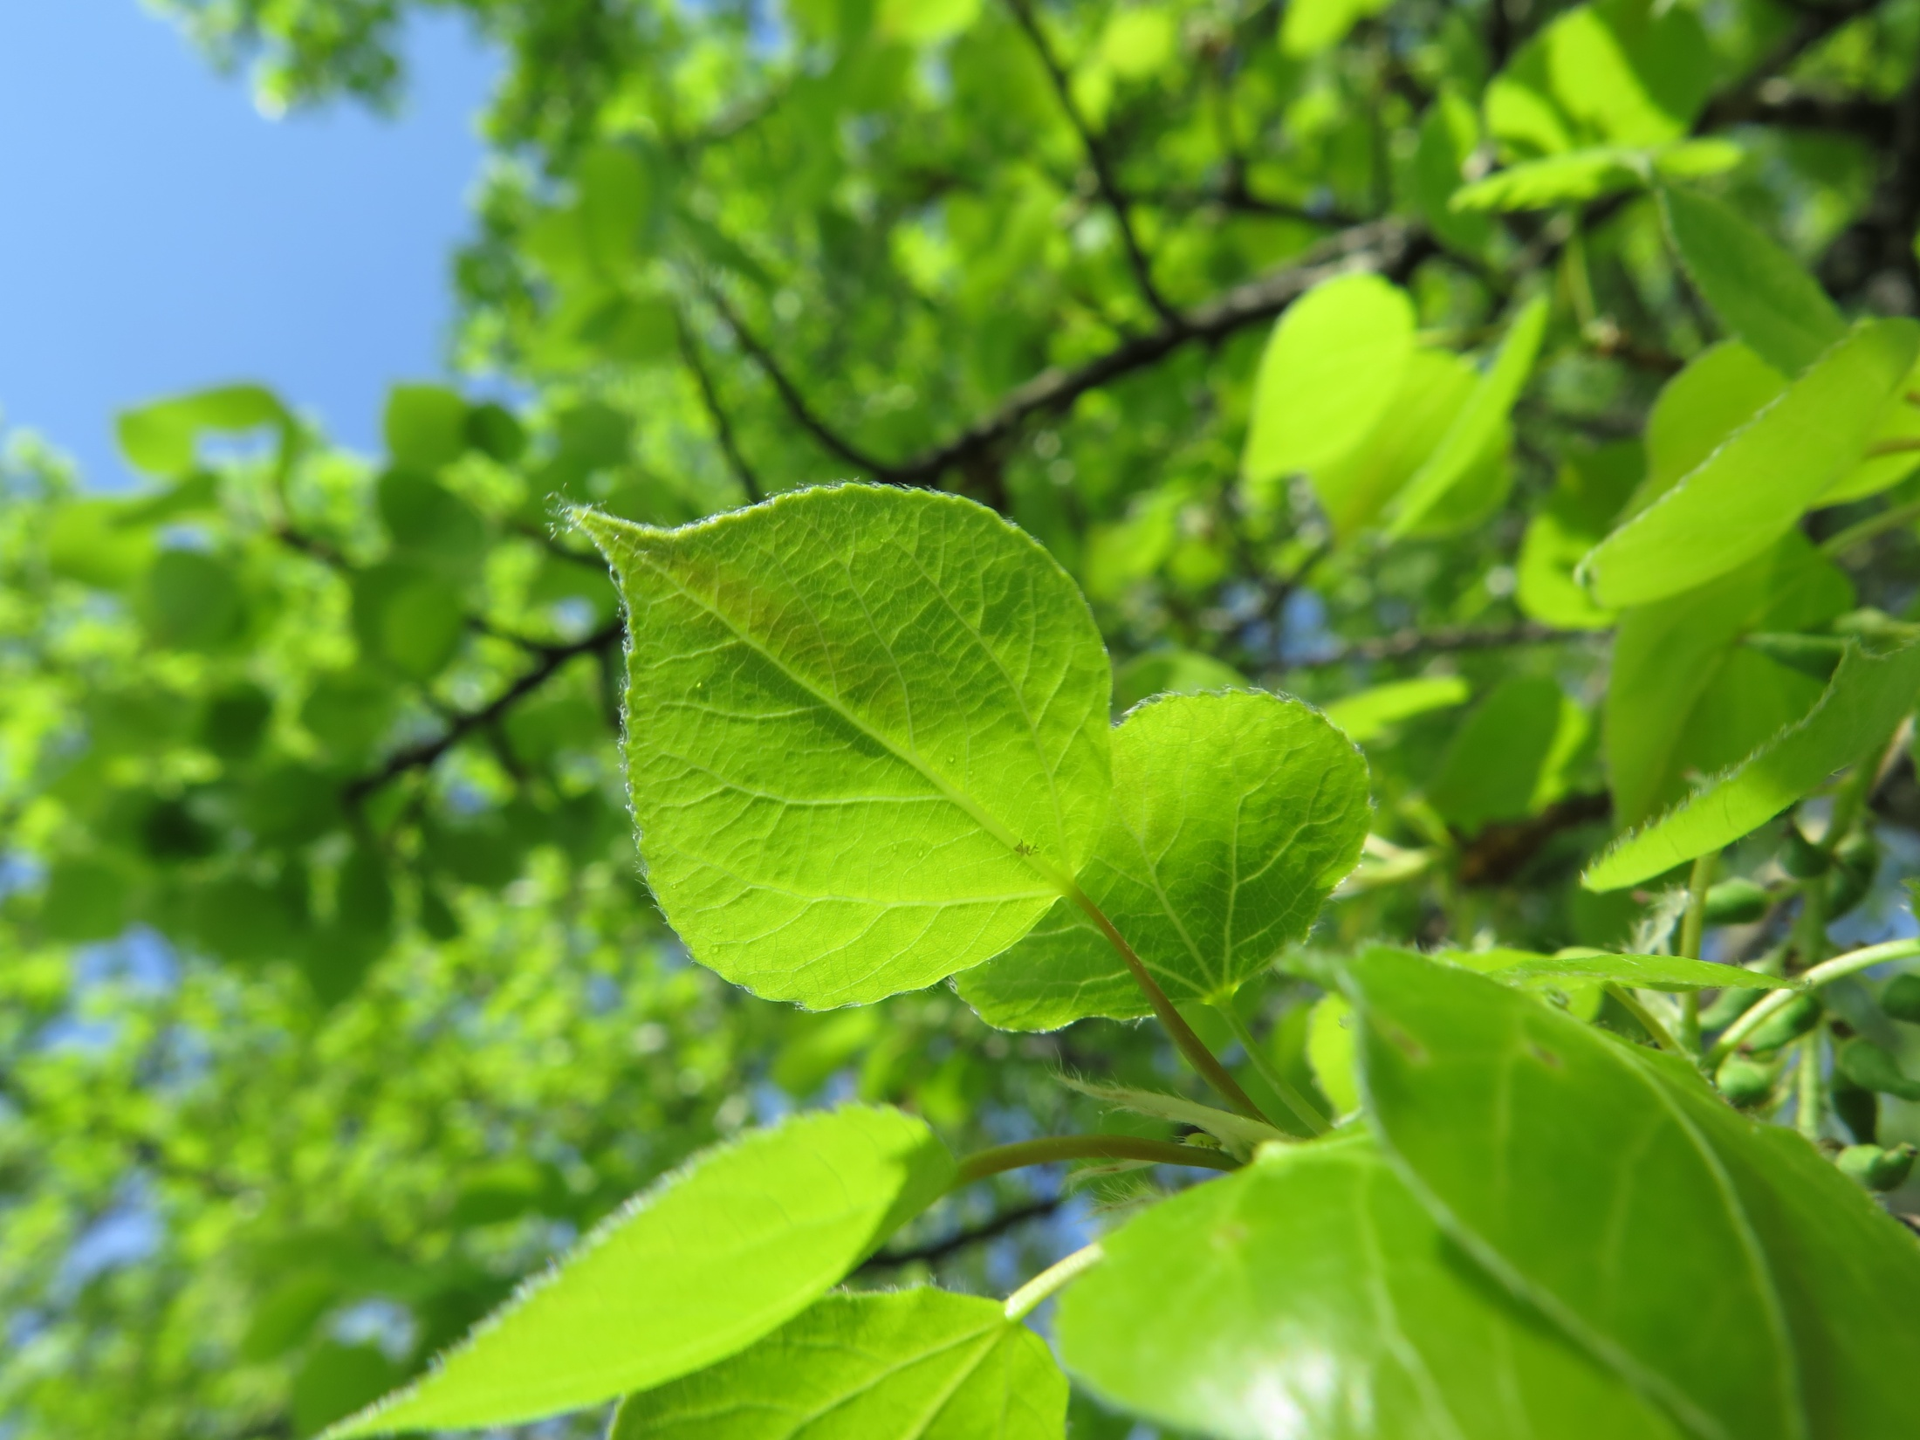
The NorthStar Chronicle
April 2017

Slide 2
Board Game Review
by Josh Van Gaalen
Are you ready to get swept up in the most successful table game franchise since Monopoly? Meet Donald X Vaccarino's Dominion. The dominant gameplay mechanic is completely original (though several games published since have borrowed it)- each player builds their own deck of cards from a randomly selected "shop" of ten card types, accessible to all the players. The randomness of the card selection makes for over five quintillion (that's 5,000,000,000,000,000,000) possible games assuming you play with all 9 expansions, so the possibilities are almost literally endless. (Another big number- playing 1 game per hour, it would take you 570 quadrillion years to exhaust all the possibilities.) The basic idea of the game is fairly simple- each player starts with an identical ten-card deck (representing their kingdom) of extremely basic cards, and alters the makeup of their deck by purchasing new cards or playing cards that allow them to 'gain' or 'trash' cards from their deck. The game ends when three card piles from the general supply run out (the province pile, the highest-scoring victory point card, counts for three), and the player with the most victory points in their deck wins!
Although there could be almost nothing further from an abstract strategic game as Dominion, it relies heavily on interactive strategy, since winning relies on picking and choosing cards from an ever-changing selection to add to your deck. The aspect of general skill is slight, since there is no feasible and consistent way to "team up" or show favouritism to other players, but specialized skill can come into play slightly more often, as experience with the cards from different expansions and how they work together can help in building strategies. Dominion has almost no uncontrolled chance aspect, since all chance that shows up in this game is either the interactive strategy of the changing card selection or the controlled chance of deck construction. The defining aspect of this game, however, is controlled chance; in fact, one could say that the genres of collecting and deck-building games corner the market on this gameplay aspect. Every card in your deck is affected by the players; either you purchase cards that will help you, or other players inject low-value cards (such as curses, ruins, and copper cards) into your deck to slow you down. This means that an astute player could keep a mental inventory of everything in their deck and calculate the probability of drawing any given hand of cards.

Slide 3
There’s a reason Dominion is such a high-grossing board game (35 million copies sold the last time I checked). It’s the first game of its kind, boasting the slogan “the board game that created a genre”. The excitement and variety of combining a huge selection of cards from all the expansions keeps it fresh. The cards are well balanced- this is partly a result of Vaccarino’s literal army of gametesters- and I would recommend Dominion to anyone looking for a table game that is sure to remain a classic for years to come.
Game Aspects in Dominion (rated from 0-10):
Strategy:
Abstract- 0
Abstract strategy games are generally unthemed and are based simply on brainpower; players contend on a mental ground free from secrets or surprises. All pieces on the board are usually visible to all players, and strategies can potentially consider all possible outcomes of a certain decision. Some games that rely heavily on abstract strategy are Chess, Checkers, Abalone, Othello, and Push Fight.
Interactive- 7
Interactive strategy is not, as one might think, an aspect of interacting with other players, but rather interaction with the game itself. In games utilizing this aspect, the game is an interactive and dynamic entity that the players must react to and build their strategy around. Some games that use this aspect well are Power Grid, Pandemic, Agricola, and Escape from Atlantis.

Slide 4
Skill General- 1 General skill is perhaps most well known in association with party games, as it revolves around inter-player interactions that may not even be incorporated into the game. However, such games are not actually an optimal example of this game aspect, since their skill set is a mixture of general and specified skill. General skill incorporates bargaining, teaming up, and bluffing, making it common in economically-themed games such as Pit, Monopoly, and Settlers of Catan. Specified- 2 Specified skill is just that- specified. Games with specialized skill are usually the hardest to master, since the set of skills required to excel at them is unique to each game. Specified skill may involve the task versatility of party games like Quelf, Cranium, and Charades, the linguistic dexterity of Scrabble, the guessing skill of Balderdash, Scattergories, and Pictionary, or the useless knowledge (sorry trivia fans!) of games like Trivial Pursuits and Scene It. Chance Uncontrolled- 1 Think dice, cards, spinners, and other methods of randomness, and you are probably thinking of uncontrolled chance. This game aspect is the source of many a debate, since some people hail its ability to level the playing field so that anyone can win, while others bemoan the fact that that its level of interaction with the game is so low that a human could lose to a rock. (Exception- rock-paper-scissors!) Many games that rely solely on this game aspect could work out that way- Candyland, Sorry, and Snakes-and-ladders, to name a few- but this aspect mostly works in the shadows to provide a bit of Deus-ex-Machina to larger, more complicated games. Controlled- 9 Controlled chance is fundamentally the art of calculating probability and stacking the odds in your favour. Any game that allows players to mess with the in-game random generation mechanism (adding or removing dice, cards, etc.) contains this game aspect. It is found almost exclusively in deck building games like Dominion, collector’s card games like Pokemon and Magic: The Gathering, and sundry other games like Rattlebones, with a slight appearance in some uncontrolled-heavy games like Yahtzee.

Slide 5
Something new to try this month that will
improve your health…
Health Corner
by Simon Perry
Miso!!!!
Sometimes called “wine of the Orient,” Miso is a slow-fermented soybean paste that is indispensable to Japanese cuisine.
Miso is a Japanese fermented creation which frequently replaces tea or coffee in Japanese culture. Manufactured from soybean paste and salt, Miso was originally completely homemade but the industrialization of the process has resulted in the general extinction of homemade varieties. (Linda Gabris, Miraculous Miso, Toronto Vitality Magazine).
Miso is a detoxifying food with power to rid the body of unwanted elements, including radioactive substances. The rich brown paste contains an alkaloid which attracts heavy metals and draws them out of the body. Besides being a powerful agent against radiation, miso is reputed to neutralize the effects of smoking and other environmental pollutants. Because of the high protein, vitamins and minerals content it’s no surprise that the longevity of Japanese people is often attributed to their healthy eating habits, many of which contain this wonder food.

Slide 7
CAUGHT
by Janaya Klassen
I sneaked peeks down the Wal-Mart aisle as I slipped the fragile bottle into my jacket. Turning around and seeing no one in sight, I hurriedly strutted down the polished floor. Holding my head high, I took a deep breath and continued to the doors. All of a sudden I crashed into someone and we both fell to the floor. SMASH! The bottle slipped from my pocket, shattering in front of me. “Security!” the girl I ran into hollered. I scrambled to get up and run while the people around me scattered. Looking back, I saw the girl I ran into trying to stop me, when I crash into another being. “Who are you?” a voice asked with authority. I glared at the person who I’d run into. Turns out, it was the store manager, whose name tag read “Samantha McLean”. She watched me curiously as two men hauled me off the floor. “You were asked a question: who are you?” the manager repeated, as I silently glared at the young, red-headed lady with my lips sealed. “Take him to my office please,” she said. With that, we headed to a stairway.
“Okay kid, how old are you?” she asked.
I rolled my eyes and answered, “16.”
“How about your name?”
“Axel,” I added curtly.
“Okay Axel, give me one reason why I shouldn't call the cops.”
“Because… I don’t need to have more problems at home.” Wasn't the total truth, but it wasn't a total lie.
“Okay, how about ‘why did you take them.’”
“I needed them.”
“For?” she pried.
“I’ll do anything, just don't call the cops!” I burst out, panicked.
“Okay then. How can you make up for this mishap?”
“I... uh...”

Slide 8
Someone then knocked on the door and came in.
“Excuse me, I need to speak with you please.” A smaller lady, who represented a secretary appeared.
“Just a moment please,” Samantha answered with a sigh.
“Don’t move.” she said, pointing a finger at me threateningly. I sat deeper in my seat to figure out how to fix this mess.
I needed the pills I stole for the ‘psycho hobo’ down the street. For an old uncared for person he really wasn't all bad. I got to know him when I accidentally spilled all my schoolwork in a puddle. He helped me clean it off and saw my bad marks. Over time we began meeting and he helped me with my math. Turns out he went to college for engineering, but got kicked out because of his addictions, which was one thing he really regretted, and which is also the reason I’m not supposed to talk to him. Now he was suffering from some sort of bad cough. My thoughts were interrupted when Samantha McLean walked in.
“Where were we… right! How will you make up for this mishap? You never told me why you took the pills either…”
She paused, looking at me hopefully. I hesitatingly began to speak,
“A friend, who I’m not supposed to talk to. He needs them.”
“What kind of friend? Like another druggie, and you're helping him out, or what?” she asked. Did I mention she was the talkative, bubbly type?
“No. A sick friend who can’t afford them. Neither can I.” I mumbled the last part.
“Well what are we gonna do with you now? Any ideas?”
“What if I work for you for a few days or something? Like work off that bottle and another or something?” I asked hurriedly.
“How do I know that you won’t steal anything else?”
“Umm... you don’t? Please anything!”
“What if I got you to…” trailing off, she almost jumped out of her seat with excitement.
“Have you ever pranked anyone before?” she asked excitedly. I remembered pranking a friend by covering his car with sticky notes once.
“Yeah, sort of,” I replied.

Slide 9
“I need you to prank someone. You will prank a ‘friend of mine’ who has put me down ten too many times. Long story short, we have been rivals since junior high, so this will be perfect! Come back tomorrow at 3:30 and we’ll discuss it.” She didn't give me time to agree or anything. Chasing me out of her office with a quick good-bye she slammed the door.
That night I googled pranks and found one that I could combine with my sticky note prank. The next day I headed to school, with my plans in my bag. School went by fairly quickly and I headed to Wal-Mart as fast as I could.
“Good afternoon, Axel! You're early,” Samantha greeted me.
“Yeah, I’ve got the perfect plan. What time does this ‘friend’ get off work and where does she work?”
“Just next door at Remax Realty, and at 5:30, why?”
“Here’s the plan…”
I showed her what I was thinking and we headed around the store. Three cartfuls of marshmallows and half a cart of sticky notes later, we and two other workers went to find her car.
“Here it is!” Samantha squealed excitedly. She insisted that I called her Sam instead of Samantha because she thought Ms. McLean made her sound like an old school teacher.
The car was a brand new, shiny red BMW. Of course it was locked, so I began picking the lock.
“What are you doing?! The alarm is gonna go off!”
“Calm down, I’ve done this before,” I answered, annoyed.
“When?”
“That’s not important…” I began before I heard a click.
“Got it!” I said.
Two of us began dumping the marshmallows into the car while the other two put sticky notes on the outside. I checked the time. It was 4:30.
“We’re running out of time! Go, go, go!” I called to the others. We finally finished at 5:15 and took off with the carts down the sidewalk, laughing.
We put the carts away and sneaked back to watch her reaction.

Slide 10
“Get down!” Sam threw me to the ground as the “friend” headed to her vehicle. Peeking through another vehicle’s window, we saw her stop for a second annoyed that her car was colorful, but she continued to unlock her vehicle. Just as she opened the door, we heard her scream. She ran around her vehicle screaming at the top of her lungs. We almost gave ourselves away laughing. Eventually we snuck away and headed back to Sam’s office.
We were almost there when Sam handed me something. I looked down; it was the pill bottle.
“If I find out these were for some random drug-addict kid, I will find you and you’ll regret it. Got it?” I stared at her wide-eyed.
“Yes ma’am and thank you!” I screamed as I ran for my bike
“See you later!” she called back laughing.
I zoomed down my home-street to find Max. Remember the homeless guy? That’s Max. I found him sitting under a tree, coughing up a storm. I stopped beside him and began to pull stuff out of my bag. Water, the bottle of pills, a bag of chips, and some pepperoni sticks.
“Boy, you don't have to do this for me. I deserve what I already got!” he said.
“Too late.” I answered smiling. I handed all the stuff to him and got ready to leave for dinner.
“Why you do this, I have no idea.” the old man laughed.
“You need this, and it’s the least I can do. Now I’d better go before mom notices.” I laughed.
“Thank ya kindly, Axel. The only friend in years!”
“I’ll see you tomorrow, Max!”
“Later, my boy!” I heard him call back. So far this had been one of the best days I’d had in a long time.

Slide 11
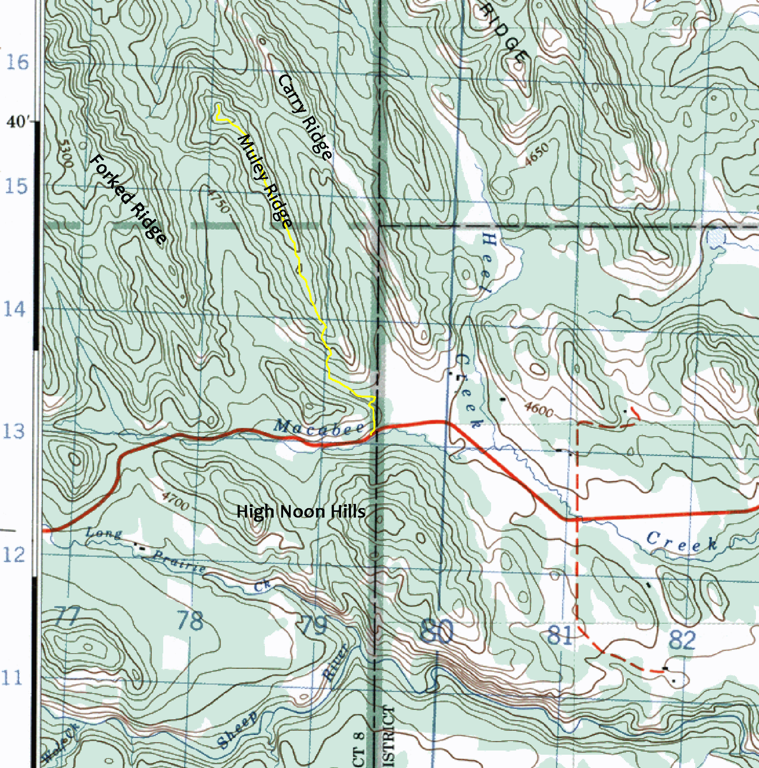
PLACES TO GO
by Gabriel Jones
Muley Ridge
Overview
Near the eastern boundary of Kananaskis Country in the Sheep River Valley there is a series of parallel ridges, all of them offering superb walking, especially in the shoulder seasons of spring and fall. Muley Ridge is the middle one. Its crest is a mix of aspen and pine woodland with occasional openings offering views across the other parallel ridges and into the Sheep Valley, and it makes a fine easy hike.
Access
From Calgary, drive west on Hwy 22X, then south on Hwy 22 to the town of Turner Valley. In Turner Valley is a four way junction. Turn right (west) on Hwy 546 and turn right at the top of the hill (still on Hwy 546). The highway leaves the town and follows the Sheep River Valley westward. Eventually you’ll see the big wooden Kananaskis Country sign. Beside the sign is a pullout with room for a few vehicles. Park here.
Yellow line shows route

Slide 12
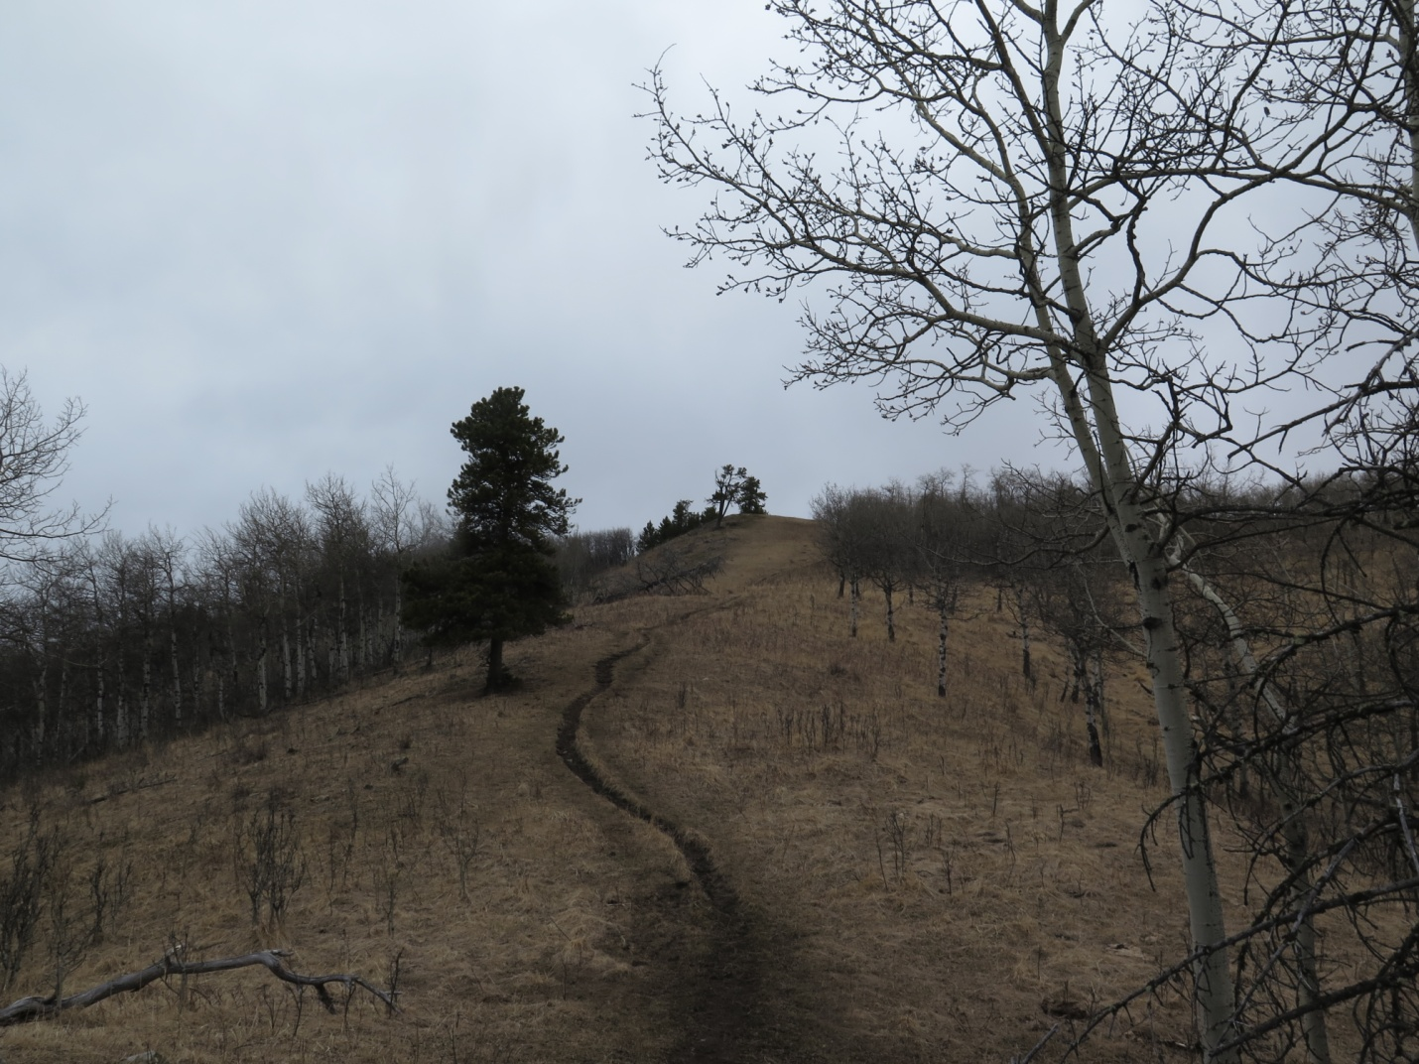
The route
From the pullout, a trail climbs up and right into the trees. It then climbs alongside the K Country boundary fence to the crest of a ridge, then descends slightly to a drift fence with gate. Cross the gate and go left onto a rather muddy cow trail. This trail zigs left then right into valley bottom of Heel Creek. Cross the creek (culvert) and turn left, following the creek’s north bank. A trail picks up, going below a steep open ridge spur. Shortly come to a junction where a trail turns right up a spur of Muley Ridge that is partially open with limber pines. Go up this spur, which leads onto the crest of Muley Ridge.
Looking up the spur which you climb to get onto Muley Ridge.

Slide 13
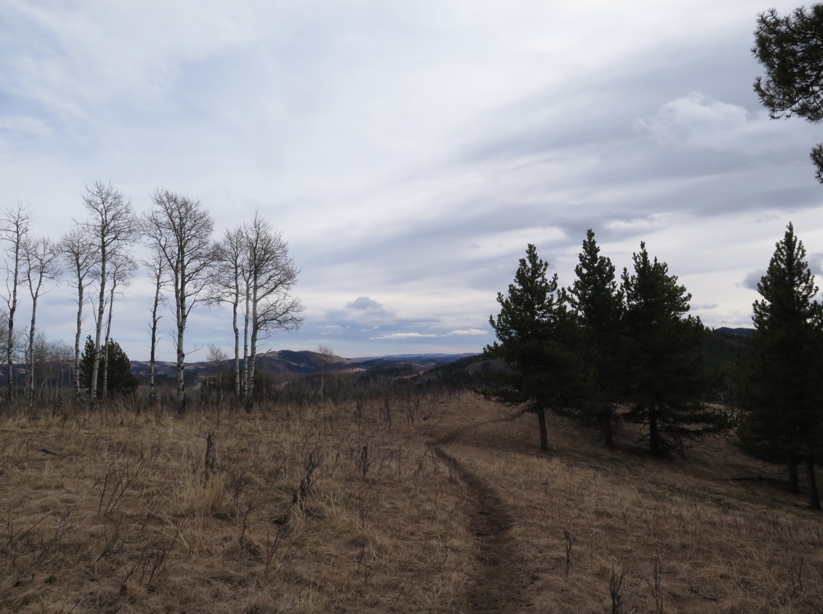
Looking back from just beyond where you first gain the ridge
Follow the trail north along the ridge through alternating patches of aspen and pine forest. Where it turns right off the ridge, continue to follow the ridge. Shortly reach the first of three equal-height high points. Go on to the next one (veering slightly left) which has a good view to the southwest, and then veer slightly right through a thicker band of trees to reach the final top.

Slide 14
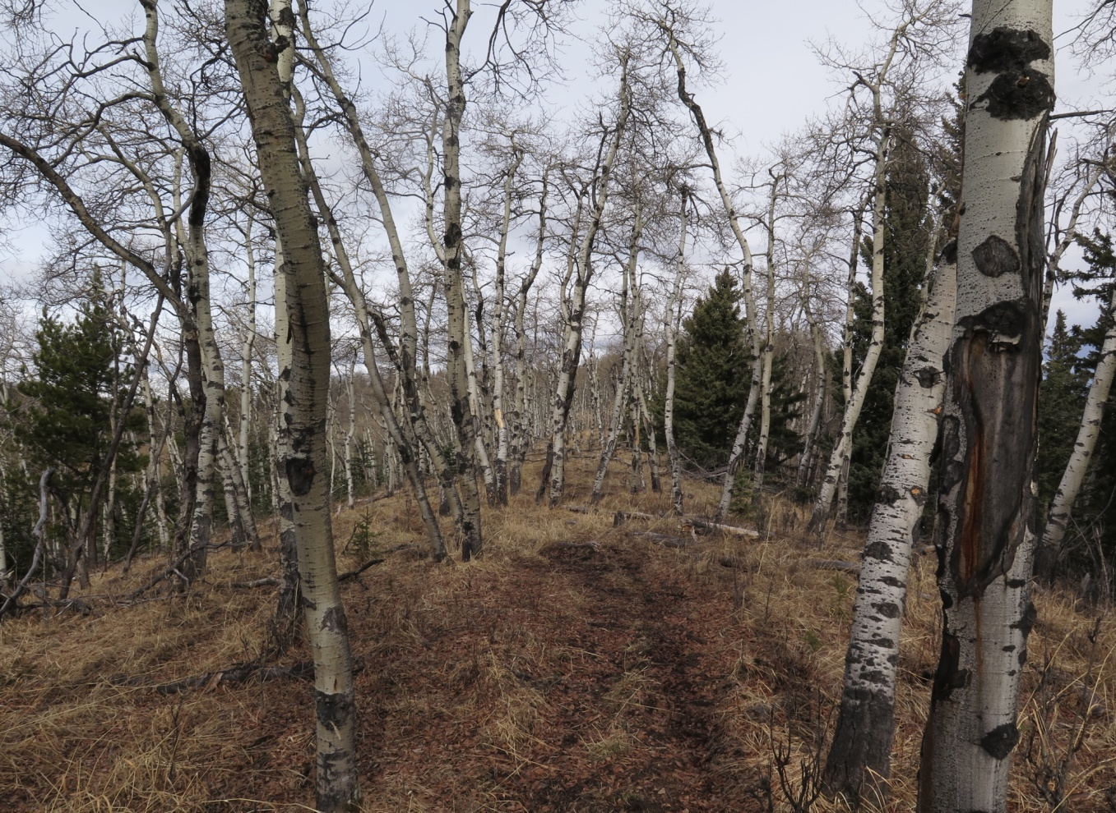
Along the ridge
Return the same way.
Disclaimer: Off-trail walking is an activity which requires skill, judgment, and knowledge which can only be gained with experience. It is shocking how some people, though capable of walking and scrambling, lack the mountain sense which is learned through years of experience of the mountains in all weathers. Until you are experienced go with someone who knows what they are doing or stick to the official trails. Turn back if it looks too hard or too long for you, if you can’t manage the routefinding, if inclement weather is coming, or if one of your group is having trouble. Mountain weather is very unpredictable and can change very fast. Temperatures can swing wildly. Always bring a compass and know how to use it. You should bring a topo map and be able to read it; maps for these regions are available from any mountain gear shop. Neither NorthStar Academy nor the author/editor is responsible if you get yourself into trouble or have any problems.

Slide 15
Contributors
Editor – Gabriel Jones
Board Game Review – Josh Van Gaalen
Health Corner – Simon Perry
Joke Time – Nicole Kitchen
Caught – Janaya Klassen
Places to Go – Gabriel Jones
Disclaimer: With the exception of grammatical/spelling errors, which are the responsibility of the Editor, the content of and opinions expressed in the material published in this magazine are solely the responsibility of the material’s creator(s) and not the responsibility of the Editor or of the other contributors.

