Slide 1
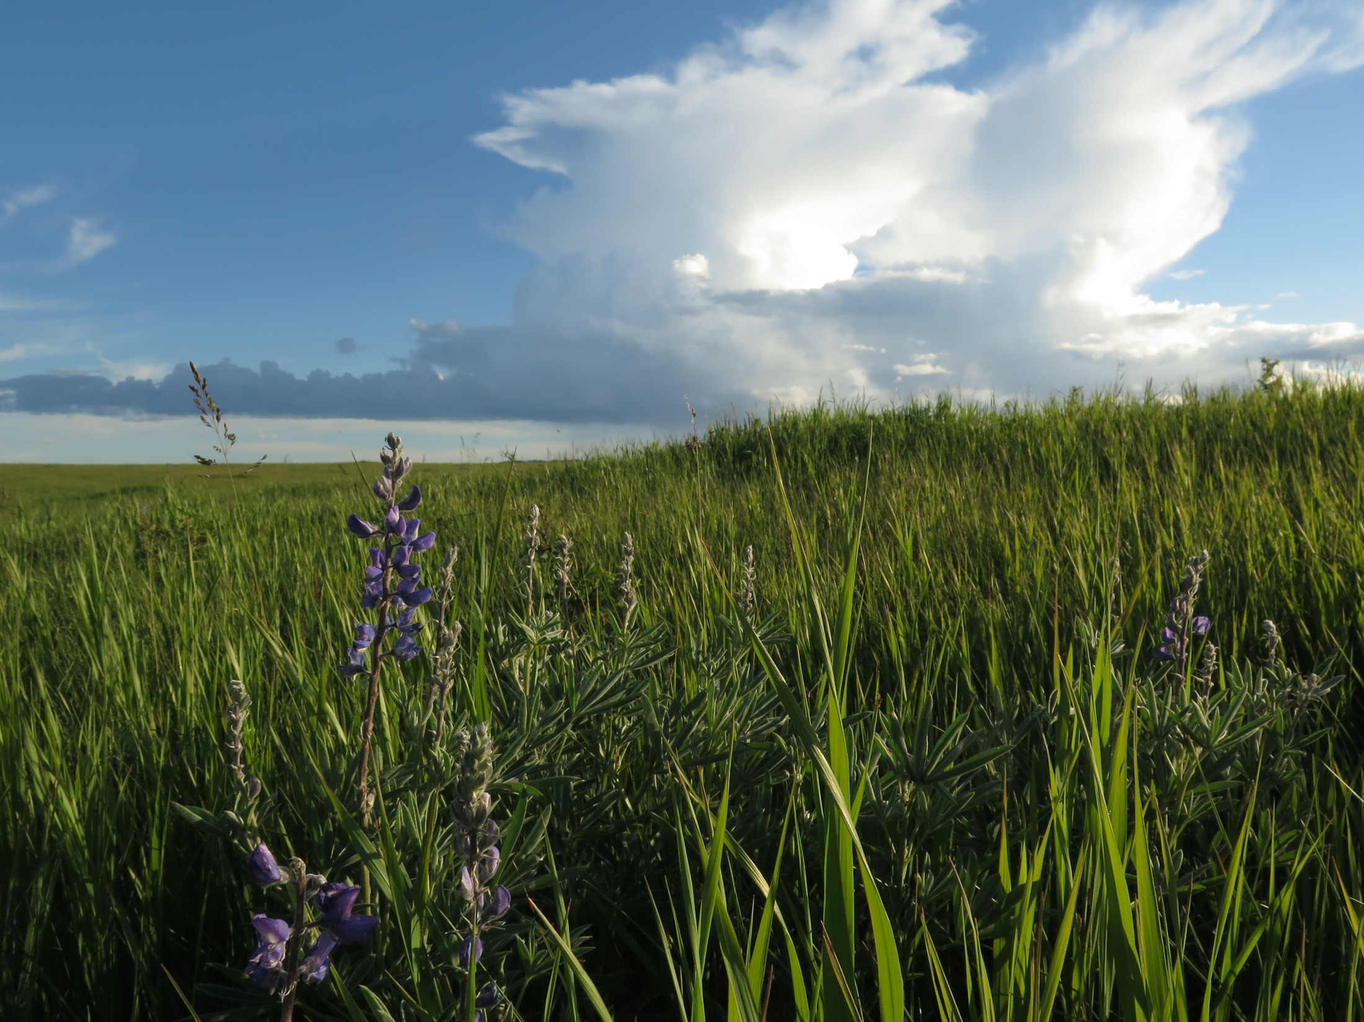
The NorthStar Chronicle
June 2017

Slide 2
Editor’s Note
by Gabriel Jones
Hi everybody!
Welcome to the June 2017 edition of the Chronicle. This issue is decidedly a summer issue, with articles on helpful summer tips (p.2), nail manicure (p.7), the Bermuda triangle (p.11), and a finally a fun hike to go on (p.15).
A special thank-you to M’ija Fraser, who agreed to write a column at the last minute when we lost two columnists to the end-of-year studying rush.
Thanks for reading!

Slide 3
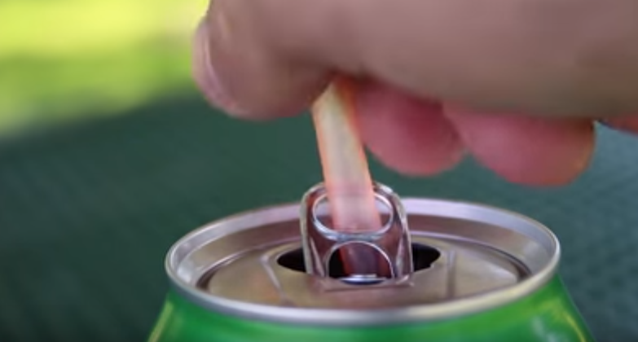
Helpful Summer Tips
A few
by M’ija Fraser
The next time you eat a hamburger, here’s a tip to help you out. Turn it upside down. The tops are almost twice as thick as the bottom and are a lot more durable.
If you drink your canned pop through a straw that doesn’t want to stay put, push the tab even further so it is over the hole. Slide your straw down through the tab and voila! No more floating straw.

Slide 4
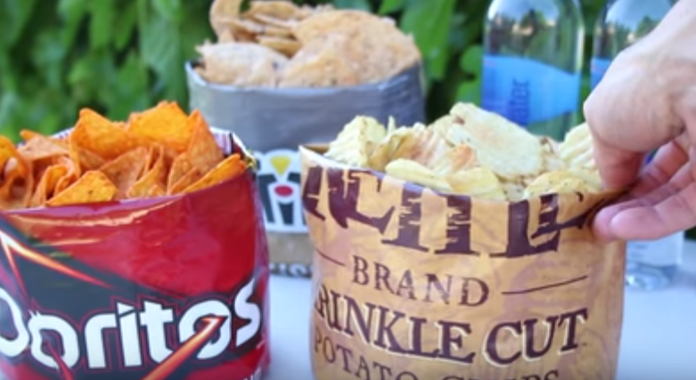
3. If you are at a party with bags of chips try impressing your friends with these custom snack bowls. First fold the top edge inside the bag, then you can begin rolling the bottom corners up into the base of the bag, which pushes the chips up as you go.
4. If you have fruit flies take some slices of banana and leftover pieces for fruit and put them in a small container. Cover the container with some plastic wrap and use something like a chopstick to poke a hole the size of a fruit fly in the center. Place the container near your regular fruit and pretty soon the flies will be there to check things out. After a few days you will have a lot of flies in there having a blast. Simply take the lid of the container and snap it on tight. The flies will not be able to escape and you will become Lord of the Flies.

Slide 5
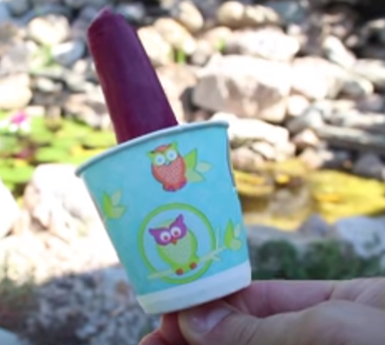
5. Popsicles melt and get sticky, so to reduce this mess take a small paper cup and cut a slit in the bottom. Slide the popsicle stick through the slit and the cup will catch the drips. This also works great with cupcake liners

Slide 6
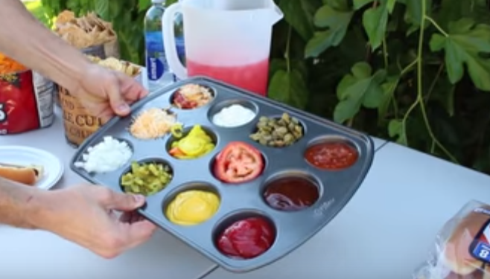
6. If you are at a barbeque the tables will most likely be filled with condiments and people taking forever to decide which ones they want. Solve this problem by using a muffin tray. Fill the different spots with different condiments and the lines will move along faster.
7. If you are ever at a beach and don’t want your small valuables such as your money, phone or car keys getting stolen try hiding them in an old shampoo bottle or a wrapped up diaper. Cut a hole in the top of an old, clean, empty shampoo bottle and place your items inside, pop the lid back on and it will look like a regular shampoo bottle. Or you can take a clean diaper and place your valuables inside. Wrap up the diaper so it looks as if it’s been used. Chances are that nobody wants your shampoo or dirty diaper.
*Ideas from King of Random….

Slide 7
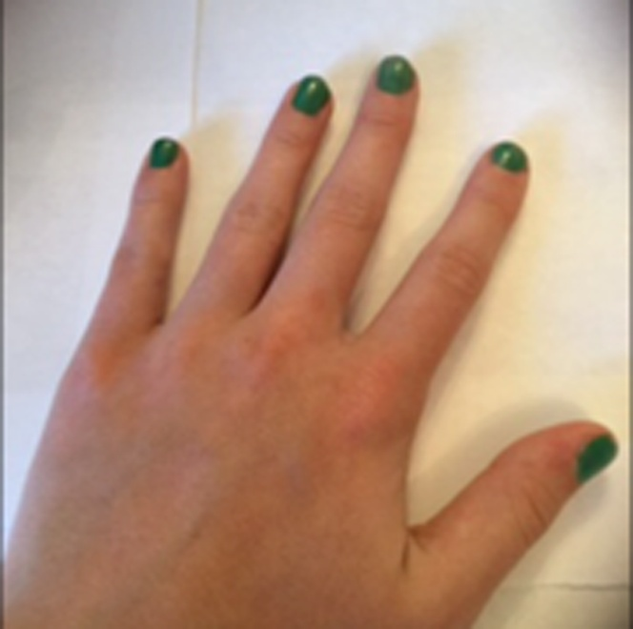
Nails With Nikki
by Nicole Kitchen
Kiwi Nail Tutorial
This is an awesome nail tutorial for summer. It's easy, it's cute, and it can be done on the shortest of nails!
To start, you're going to put on your first coat of green polish. Lighter greens are preferable.

Slide 8
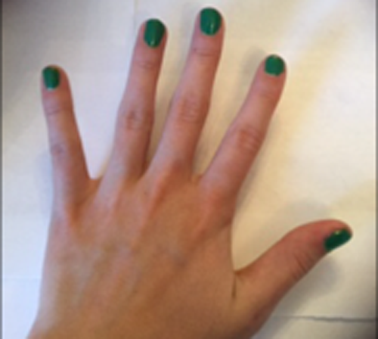
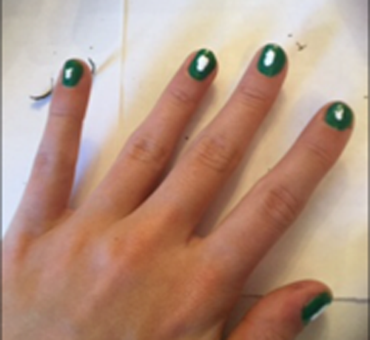
Let it dry, and put on your second coat.
Now, once they're both dry, put some thin blobs of white polish onto your nails. Don't make them too thick.

Slide 9
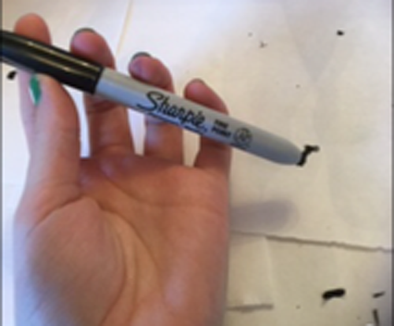
Once they dry, you're going to take either black polish and a dotting tool, or a sharpie. I am using a sharpie just to make it easier.
Just make some small dots for seeds, around your white mark. They don't have to be clear, feel free to make them cluttered.

Slide 10
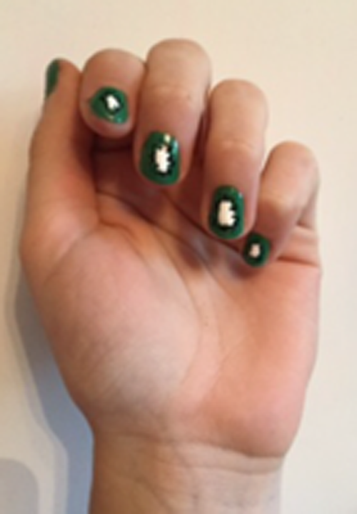
Now, apply a clear or matte top coat, and BOOM! You have some really cute kiwi nails!!
THEEEEEE ENDDDDD

Slide 11
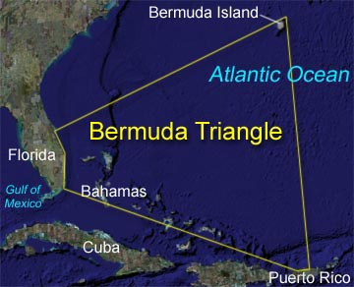
The Bermuda Triangle
by Levi Patterson
The Bermuda Triangle has a long and mysterious history of marine tragedies, and as it has recently claimed another victim on May15th, questions are once more surfacing. As one of the most traveled areas in the world, this might not be a surprise at first glance. All types of vessels traverse these waters, and flying above are both military planes and commercial airliners. The mystery lies in the consistency and diversity of these stories. Modern theorists may find it intriguing that it is a triangle of all things, but Illuminati? I think not.

Slide 12
One of the earlier recorded disappearances was of the USS Cyclops, a coal ship in the Us Navy. In March 1918, it was traveling from Bahia, El Salvador to Baltimore, Maryland, but shortly after a stop at Barbados for extra supplies, it disappeared. No distress signal was ever received. Now, it is true that it may not have been in the Triangle, but we shall move on and see what else history has to say.
December 5, 1945, Flight 19 set out from Fort Lauderdale to practice some routine bombing runs, led by Lt. Charles Taylor. An hour and half after they flew off, Taylor reported that his compasses were broken, but he thought he was flying over the Florida Keys. He was advised to fly to Miami. It turns out that he was not flying over the Keys, but instead over the Bahamas. This mistake was fatal. When it was apparent that Flight 19 was lost, other planes were sent to find them, and one of the search planes also went missing. The Flight 19 planes have been missing to this day.
December 28, 1948, NC16002, a DC-3 Airliner flying from San Juan, Puerto Rico to Miami, Florida disappeared on a fine, clear day, with only fifty miles left to the destination. It is true, though, that the plane’s batteries were not fully charged at take-off, and hence the communications between the plane and airport may have been affected.

Slide 13
The SS Marine Sulphur Queen was a tanker ship with a cargo of molten sulphur that disappeared off Florida’s southern coast in 1963. No evidence of the wreck was ever found. It is true that that type of ship had an unstable keel and this particular ship was further weakened by carrying molten sulphur, making it hardly fair to blame the Bermuda Triangle. A few explanations for these phenomena are as follows: ► In the Bermuda Triangle “flash” storms frequently occur —fierce storms that build up and break down so quickly that even satellites have trouble detecting them. These could very well be the cause of some disappearances. ► The ocean floor in the vicinity of the Triangle is known to trap and release large amounts of methane gas. Methane is quite flammable and if it explodes in the air planes could ignite and crash. As well, if enough gas rises through the water, the water’s density may drop and a ship could sink quite easily. The ocean floor in the triangle conceals many craters and cliffs, and if a ship sailed over one at the time of sinking, it might be impossible to rescue. ► Scientists have noticed a large number of seismic vibrations around the Triangle. This could cause enough disturbance to fuel one of the infrequent but powerful tidal waves that strike in the area.

Slide 14
Less likely theories include Atlantis having moved there, alien abductions and UFOs, pirates, and death rays. These seem quite unlikely; however, there exists a surprisingly large number of supporters for these theories. In conclusion, I must say that although there a large amount of factors pointing to the existence of the Bermuda Triangle, is it really a mystery? The amount of stories and theories are staggering, but there are relatively few credible ones. If you take a look at the Cape of Good Hope on the tip of South Africa, it is a stormy and dangerous place, but it does not have quite the legacy that the Triangle has, but the Triangle has a great deal more traffic. This could very well be the reason. In my opinion, the Bermuda Triangle is nothing but a place on earth that has an unfortunate amount of tragedy, not one that has some supernatural mystery.

Slide 15
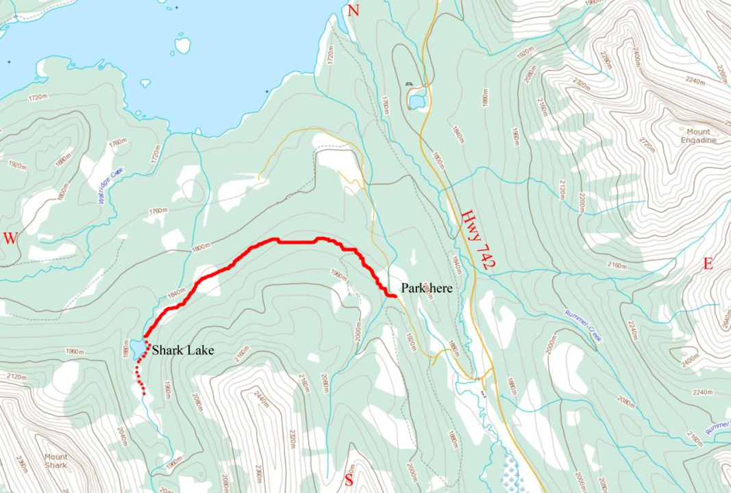
PLACES TO GO →
by Gabriel Jones
Overview
This is an easy hike to a beautiful blue-green lake tucked in the valley between Mt Shark and Tent Ridge, with the option of going farther. Don’t ask me why it’s called Shark. I’m pretty well certain there are no sharks in this lake!
Distance: 7.4 km to lake and back
Height Gain: 104 m (341 ft) to lake and back
High Point 1920 m (6300 ft)
Access
From Calgary, drive west on the Trans Canada Highway (Hwy 1). Partway through the Stoney Indian Reserve, go south on Hwy 40 (Kananaskis Trail.) Keep going all the way to the turnoff for Kananaskis Lakes Trail (a smaller side road) and turn right. Take your second right from this road onto the Smith-Dorrien Spray Trail (Hwy 742) which is well marked. Drive for many kilometers down this wide gravel road until you reach the turnoff for Mount Shark and Mt Engadine Lodge. Turn left. 1.8 kilometers in, park in a small pullout on the right side of the road. It’s just before a steep downhill. Note: This spot can also be reached by driving down Hwy 742 in the opposite direction from Canmore.
Map. Solid red line shows route to Shrk Lake. Doted red line shows route to pond.
Note that this map does not substitute a proper top map such as the Gem Trek maps.

Slide 16
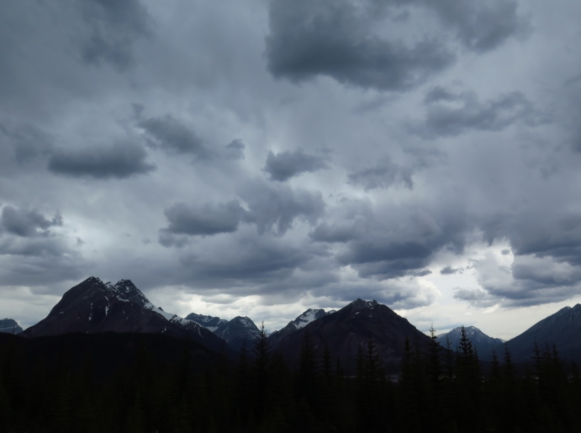
The route
From the parking area, you can see a track rising up the hillside a little way down the road. Go to this track along the road, en route crossing a stream. Then continue along the track. Soon you will come to a spot where there are logs laid across the track and a much narrower trail turns left. Ignore it (it goes up Tent Ridge) and continue along the track. At the track’s high point there is a view across the Spray Lakes Reservoir. After this the track veers left and shortly splits. Go right. The right-hand track, which you are now following, travels gradually downhill, en route offering views.
Looking across from the right-hand track to the Sundance Range. The peak on the left is Cone Mountain.

Slide 17
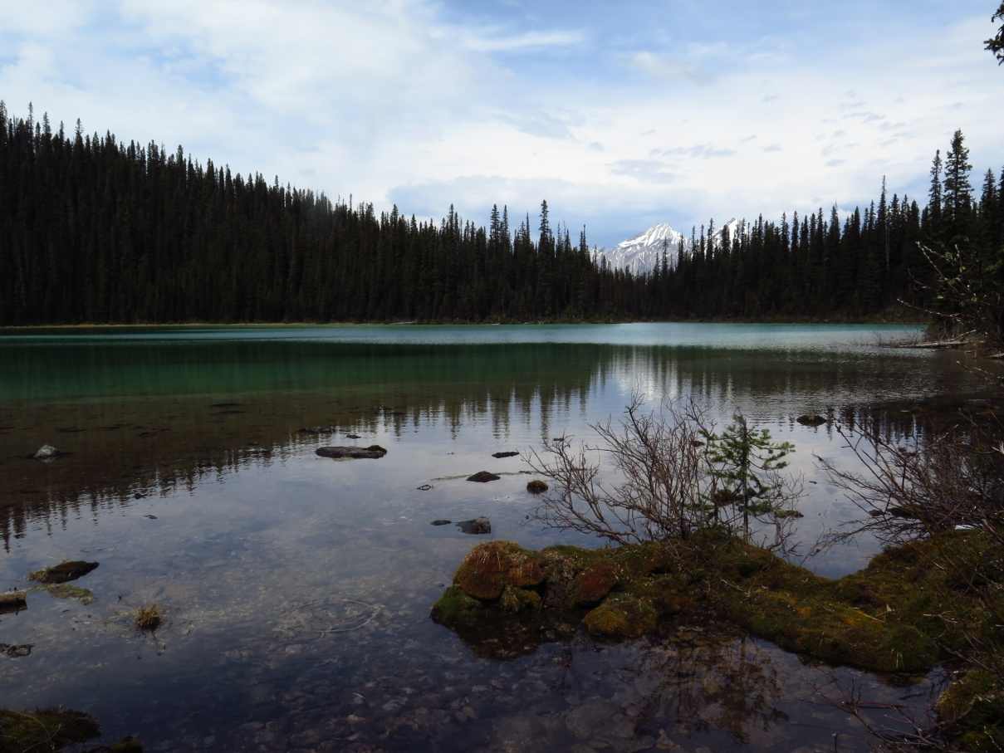
Gradually the track curves to the left (south) into the valley between Mt Shark and Tent Ridge. As it does so, it becomes a narrow forest trail. Eventually the trail reaches the lake.
The scene is spectacular: the smooth green waters backdropped by Mt Shark and the long ridge leading to Mt Smuts, which is the mountain at the head of the valley.
Looking back across Shark Lake from the far end.

Slide 18
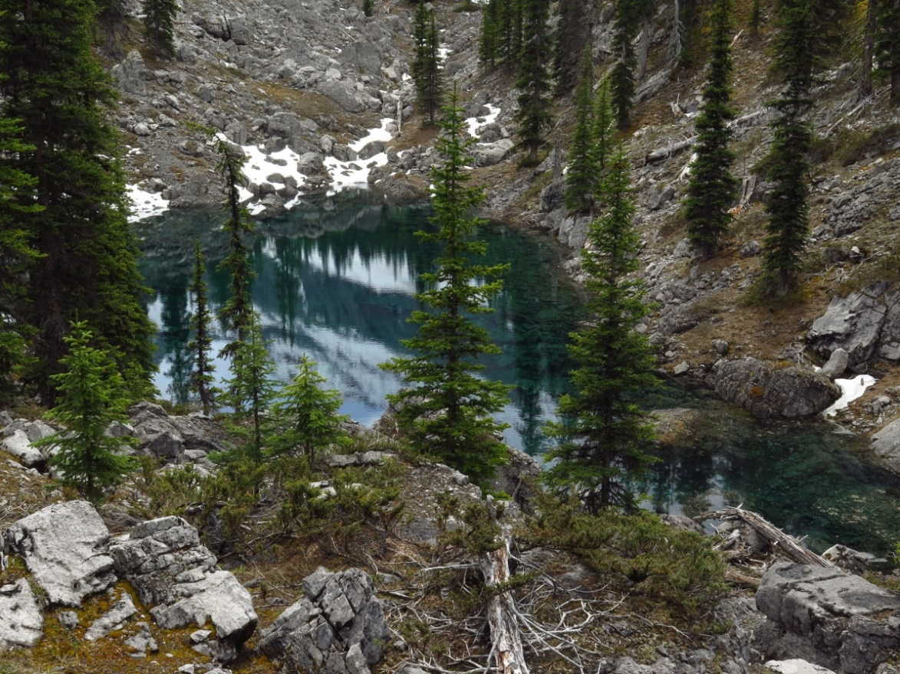
Going on? Extra 0.4 km one way
It is possible , though trickier, to keep going up the valley towards a deep blue pond. To do so, first circle around the left (east) side of the lake. Eventually you will reach the inlet stream, which is springs out of the ground a short distance above the lake below a steep hill covered in rocks. Climb this hill via its right side. Ahead is a narrow sink valley filled with very large boulders. Follow this valley, aiming to the left of the small hill ahead. Slip through the gap and descend into another sink valley. Follow this valley, being careful not land yourself in another sink valley (there are a lot of them). It leads to the edge of a very deep sink containing the blue pond.
The blue pond
Return the way you came up.
Disclaimer: Off trail walking is an activity that requires skill and judgment that only comes from experience. Shark Lake is an easy hike and the routefinding is simple, but you should at least be able to read a topo map. If you have little or no experience, first do some hiking on official trails and learn to use a topo map (and also read Gillean Daffern’s Kananaskis Country Trail Guide), or go with someone more experienced. This article is no substitute for experience and a proper topo map. Neither the author nor NorthStar Academy nor anyone else but yourself is responsible for anything that happens as a result, directly or indirectly, of reading this article.

Slide 19
Contributors
Editor – Gabriel Jones
Helpful Summer Tips – M’ija Fraser
Nails with Nikki – Nicole Kitchen
The Bermuda Triangle – Levi Patterson
Places to Go – Gabriel Jones

